Slide 1
Museums Embracing Emerging Technologies:
Bringing History Alive
Diamond Girls and Social Media

Slide 2
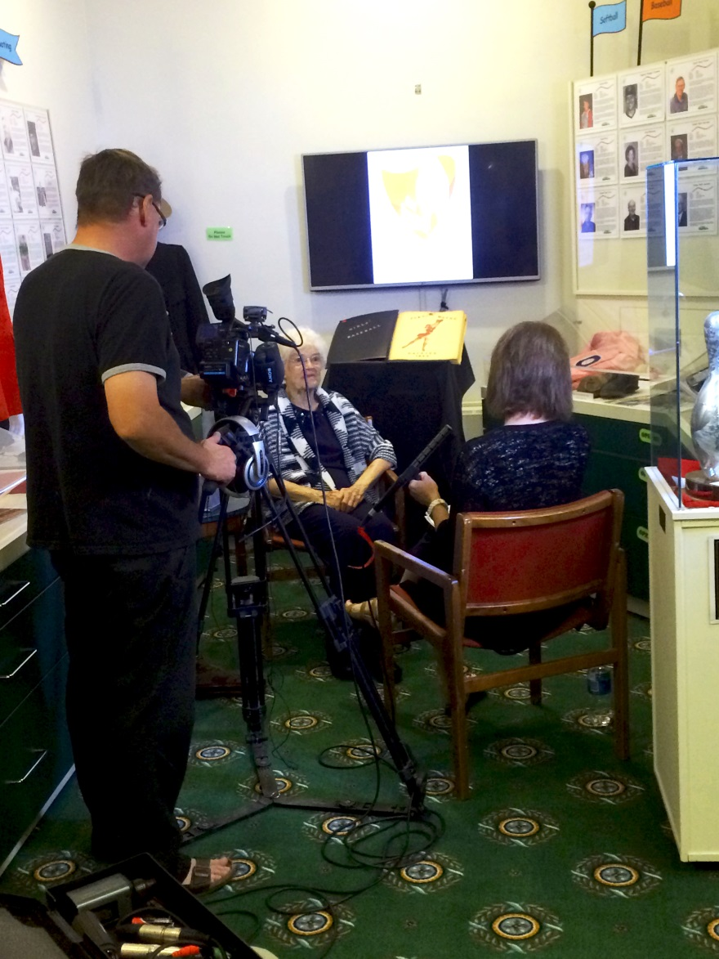

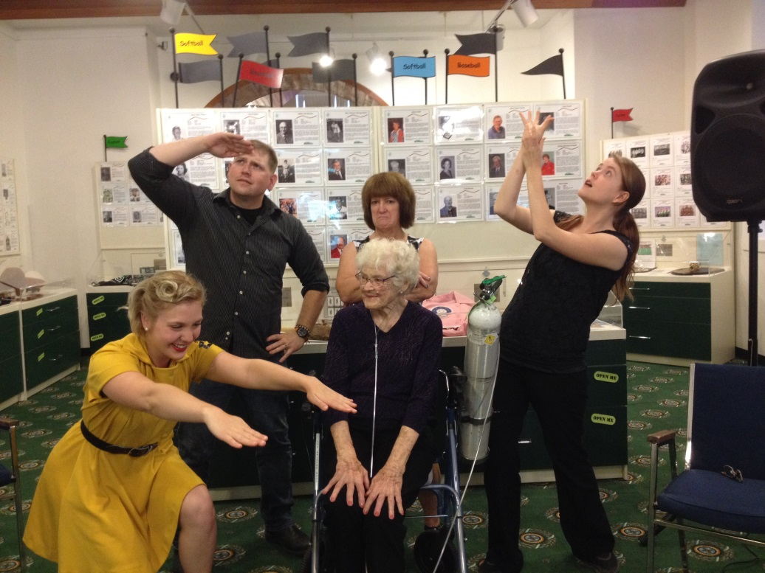
Initial interview at the SSHF
Date: October 1, 2015
Day of the Regina Premiere
Date: June 28, 2016

Slide 3

Bringing History Alive:
Question: How do you translate the excitement of a stage play into an ongoing celebration of Saskatchewan’s sport history via social media?
3 Main Contributors:
1. SSHF
2. Menagerie Productions
3. Malia Becker (Actress)

Slide 4
SSHF Social media by the numbers:
Sshf Accounts Over the course of 3 months
Twitter: 30 Tweets = 19,341 impressions.
Facebook: 8 Posts = 13,286 reach.
Website: 17% of visitors looking for Diamond Girls information (nearly 1/5 of our total visitors). Roughly 4,000/month, totaling 12,000.
Combined: 44,627 people learned about Diamond Girls though Mobile Marketing efforts.
When you consider retweets from interested parties, likes and shares, this stat easily grows to 250,000.

Slide 5
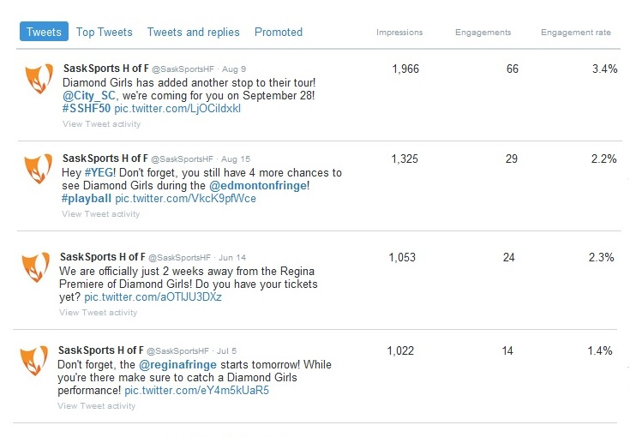
Sample of top tweets:

Slide 6

Social media was not the only type of media that we used, we also took advantage of traditional media.

Slide 7
Media Critics Review Diamond Girls:
Through these combined efforts of social media and traditional media – and their amazing performances – Diamond Girls began to receive very positive reviews
Some highlights included a FIVE star review from CBC Manitoba
“Malia Becker hits it out of the park in this summery one-hander featuring 21 characters. Some scenes involve 3 people, all played by Becker, masterfully juggled, crisp and distinct.” Shawna Dempsey, CBC Manitoba
“Becker does the characters proud and is arresting to watch, moving nimbly between characters, batting a thousand all the way.” Liane Faulder, Edmonton Journal
These positive reviews continue to build both the audience and the awareness

Slide 8
Take Away Message:
Social media is key to the marketing plan.
Traditional media is important too, but it is their online presence that is critical.
Sport history can be captured by all generations.
You don’t have to do it all on your own.

Slide 9
Stay up to date with the SSHF:
Twitter: @SaskSportsHF
Instagram: @SaskSportsHF
Facebook: Facebook.com/SaskSportsHF
Website: www.sasksportshalloffame.com
QUESTIONS?

